Slide 1
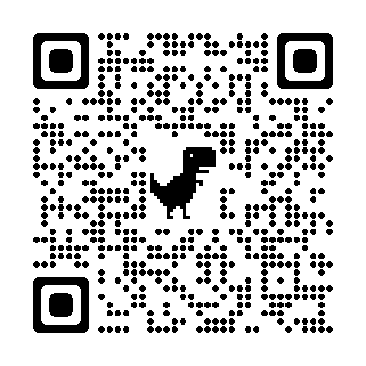
Interactive activity
For this activity you may want to sit with people so you can discuss
(this is completely optional though and can be done individually if preferred)
https://cardographer.cs.nott.ac.uk/sessions/63fc86fa6248425d4567a33a/cards

Slide 2
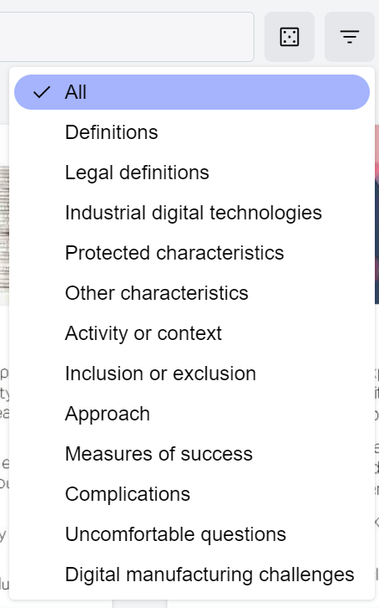
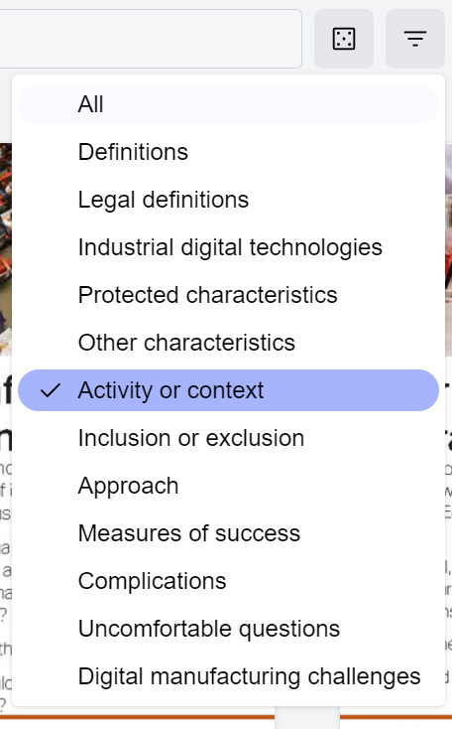

EDI cards
These EDI cards were developed by Peter Craigon, Debra Fearnshaw, Oliver Fisher and Emma Hadfield-Hudson at the University of Nottingham.
These cards used as an aid for discussion and reflection on EDI flexibly. Using these cards will not solve all our EDI issues however it is hoped they will facilitate discussion and support.
Randomly generate from categories selected
Category options
Example choosing ‘Activity or context’
Select categories

Slide 3
•Randomly generate an ‘Activity or context’ and ‘Inclusion and Exclusion’ card.
•Discuss how the two cards are related (or not related)
e.g:
If you would rather not discuss, why not write the cards you chose on the padlet and add any thoughts there

Slide 4
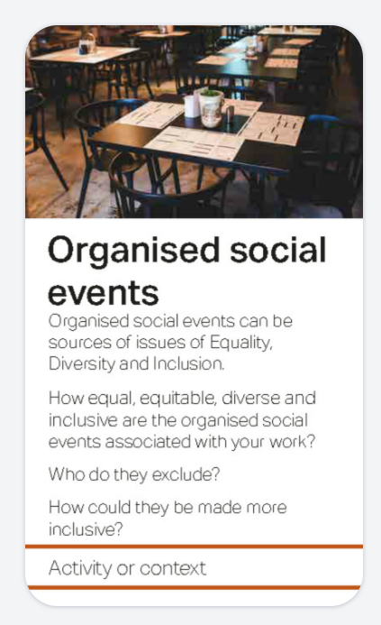
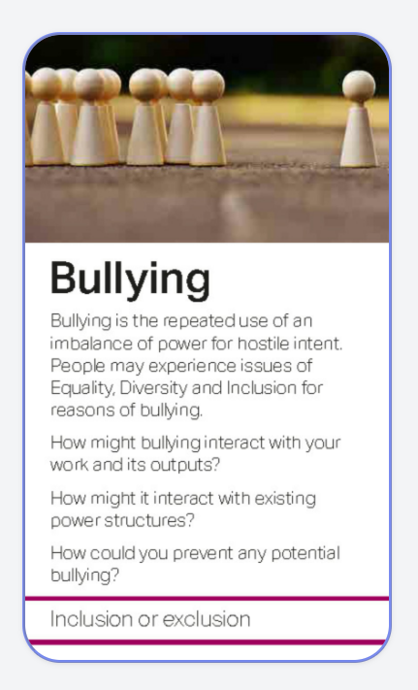
•Additionally, randomly select a card from the Protected Characteristics category
•Consider how this characteristic may or may not be impacted by the other two cards
e.g:
If you would rather not discuss, why not write the cards you chose on the padlet and add any thoughts there

Slide 5
You can now repeat this again and discuss(/contribute to the padlet) the new cards you have chosen
Whilst doing this consider:
How these relate to your experience at university
How these may relate to future careers
Would these type of conversations be ones you are usually having

